Slide 1


IIIT HACKATHON
VIDEO
GPT
Team-05
CH JAYANTH
Y N S HARSHA
S NIKHILESWARA RAO
S SAI POOJITHA

Slide 2

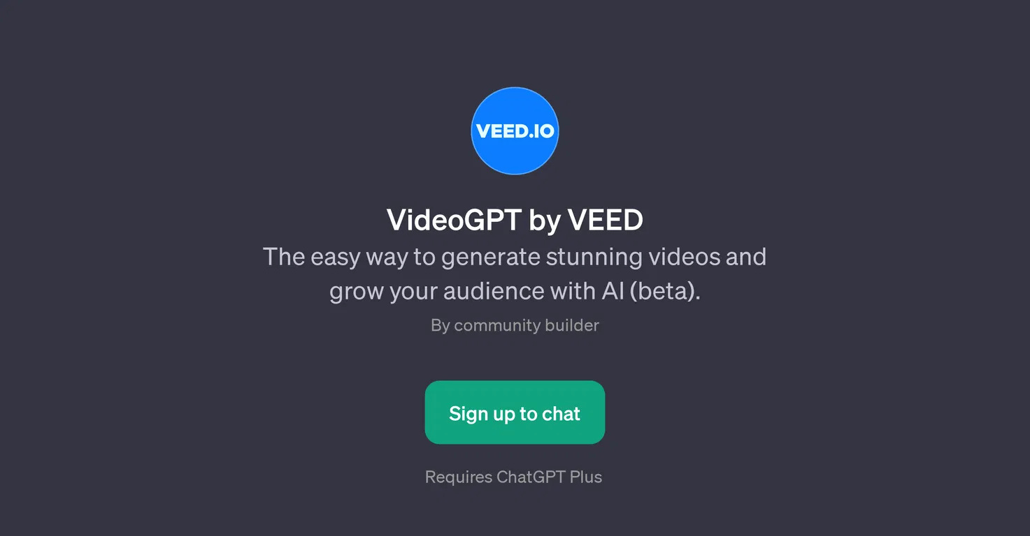
PROBLEM STATEMENT
Content Accessibility: Video content is widely used but often lacks accessible summaries, making it difficult for users to get key information quickly.
Video Search: Searching through long videos for specific information is time-consuming and inefficient.
Explainability: Pre defined models are unable to transcript the complete video given, which in turn leads to the loss of information.
Down-sampling: Lack of efficient Sampling techniques for larger videos result in loss of data.

Slide 3

SOLUTION IDEA
VideoGPT: GenAI-Powered Video Summarization and Interaction
Key Features:
Automatic Summarization: Automatically generates concise video summaries, allowing users to understand the main content quickly.
Text-Based Video Search: Allows users to search specific moments or topics in a video using natural language queries.
Question & Answer Interaction: Users can ask questions about the video, and the model provides relevant timestamps or answers based on the content.
Time Efficiency: Reduces the time needed to consume lengthy videos by offering highlights and allowing targeted search.

Slide 4




SOLUTION ARCHITECTURE
The video is given as input to the Decoder
DECODER
Decoder splits the video into 1sec sub videos
All the frames in 1sec videos are redundized in
sampler
SAMPLER
Redundized frames are trained to give captions for each frame and summerized
MODEL
SUMMERIZER

Slide 5


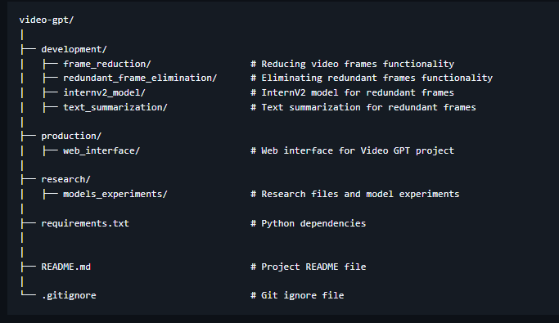
CODE DESCRIPTION
REPO LINK
WEB LINK

Slide 6
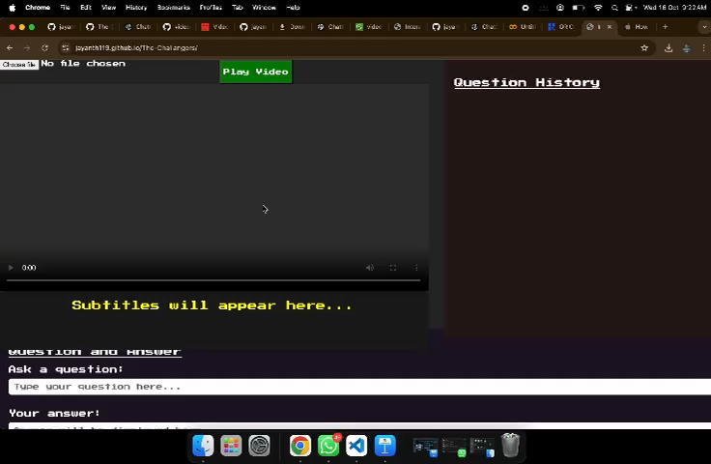
DEMO

Slide 7
THANK YOU!

